Slide 1
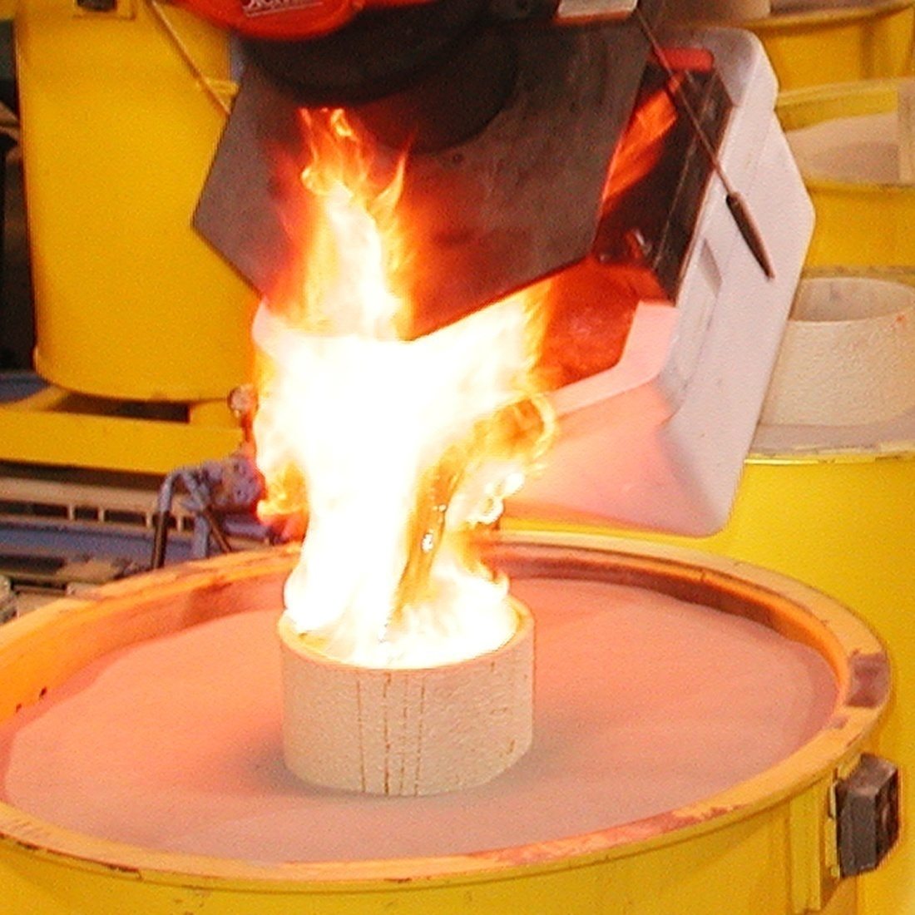
Metal-Casting Processes

Slide 2
INTRODUCTION
The first metal castings were made during the period from 4000 to 3000 B.C., using stone and metal molds for casting copper. Various casting processes have been developed over time, each with its own characteristics and applications, to meet specific design requirements. A large variety of parts and components are made by casting, such as engine blocks, crankshafts, automotive components, power trains, agricultural equipments, railroad equipment, pipes, plumbing fixtures, power-tool housings, gun barrels, frying pans, jewelry, orthopedic implants and very large components for hydraulic turbines.

Slide 3
Two trends have had a major impact on the casting industry. The first is the mechanization and automation of the casting process, which has led to significant changes in the use of equipment and labor. Advanced machinery and automated process-control systems have replaced traditional methods of casting. The second major trend has been the increasing demand for high-quality castings with close dimensional tolerances.

Slide 4
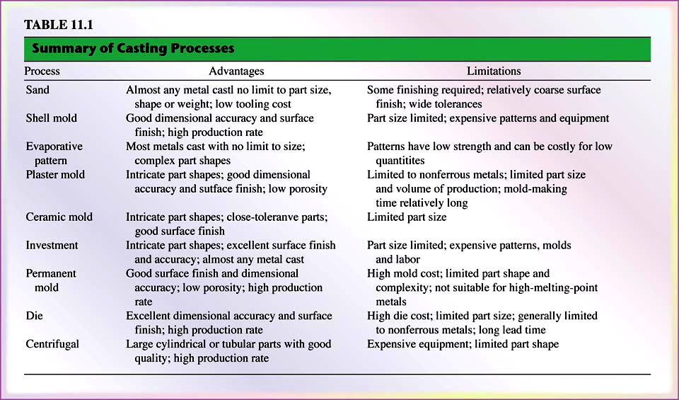
Summary of Casting Processes

Slide 5
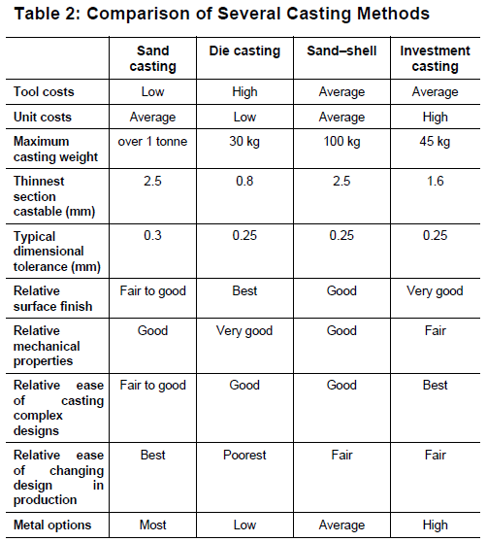

Slide 6
Casting processes classifications are related to mold materials, pattern production, molding processes and methods of feeding the mold with molten metal. The major categories are as follows:
1- Expendable Molds: Expandable molds are made of sand, plaster, ceramics and similar materials. These are mixed with various binders for improved properties. A typical sand mold consists of 90% sand, 7% clay and 3% Water. After the casting has solidified, the mold is broken to remove the casting. The mold is produced from a pattern; in some processes, like sand and shell casting, the mold is expendable, but the pattern is reused to produce several molds. Such processes are referred to as expendable-mold casting process.

Slide 7
Permanent Molds: Permanent molds are made of metals which maintain their strength at high temperatures. This type of molds is used several times. Permanent molds are designed in such a Way that the casting can be removed easily and the mold used for the next casting. Metal molds are better heat conductors than expendable nonmetallic molds; hence, the solidifying casting is subjected to a higher rate of cooling, which in turn affects the microstructure and grain size within the casting.

Slide 8
Composite Molds: which are made of two or more different materials (such as sand, graphite and metal) combining the advantages of each material. These molds have a permanent and an expendable portion. Composite molds are used in various casting processes to improve mold strength, control the cooling rates and optimize the overall economics of the casting process.

Slide 9
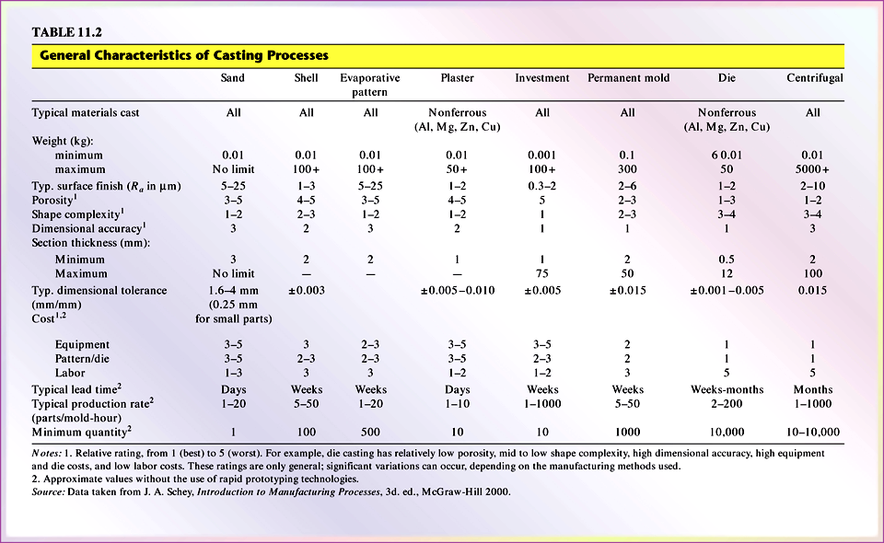
Characteristics of Casting

Slide 10
Expendable-mold, Permanent-pattern Casting Processes
The major categories of expendable-mold, permanent-pattern casting processes are sand, shell mold, plaster mold, ceramic mold and vacuum casting.

Slide 11
Sand Casting
The traditional method of casting metals is in sand molds and has been used for millennia. Sand casting is still the most prevalent form of casting; in the United States alone, about 15 million tons of metal are cast by this method each year. Typical applications of sand casting include machine bases, large turbine impellers, propellers, plumbing fixtures and a wide variety of other products and components.

Slide 12
Basically, sand casting consists of (a) placing a pattern (having the shape of the desired casting) in sand to make an imprint, (b) incorporating a gating system, (c) removing the pattern and filling the mold cavity with molten metal, (d) allowing the metal to cool until it solidifies, (e) breaking away the sand mold, and (f) removing the casting

Slide 13
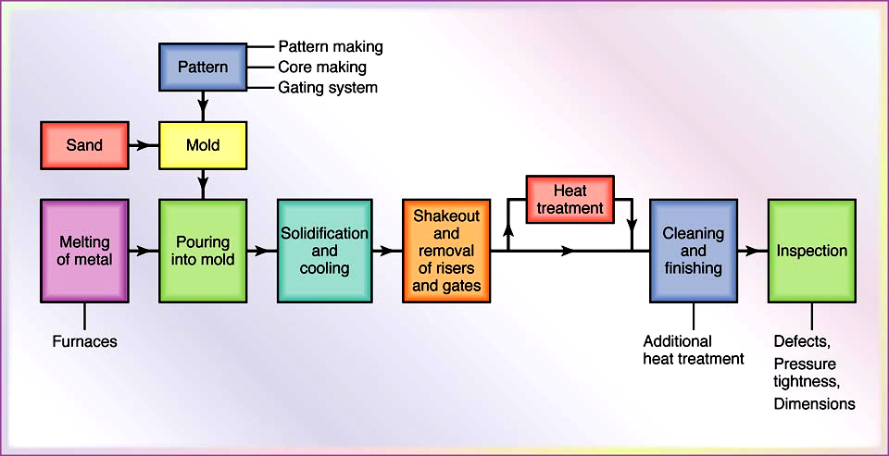
Production Steps in Sand - Casting
Outline of Production steps in a typical sand-casting operation.

Slide 14
Sands
Most sand-casting operations use silica sand (SiO₂) as the mold material. Sand is inexpensive and is suitable as a mold material because of its high-temperature characteristics and high melting point. There are two general types of sand: naturally bonded (bank sand) and synthetic (lake sand). Because its composition can be controlled more accurately, synthetic sand is preferred by most foundries. For proper functioning, mold sand must be clean and preferably new.

Slide 15
Several factors are important in the selection of sand for molds and certain tradeoffs with respect to properties are involved. Sand having fine, round grains can be packed closely and thus forms a smooth mold surface. Although fine grained sand enhances mold strength, the fine grains also lower mold permeability (where fluids and gases penetrate through pores). Good permeability of molds and cores allows gases and steam evolved during the casting to escape easily. The mold also should have good collapsibility to allow the casting to shrink while cooling and, thus, to avoid defects in the casting, such as hot tearing and cracking.

Slide 16
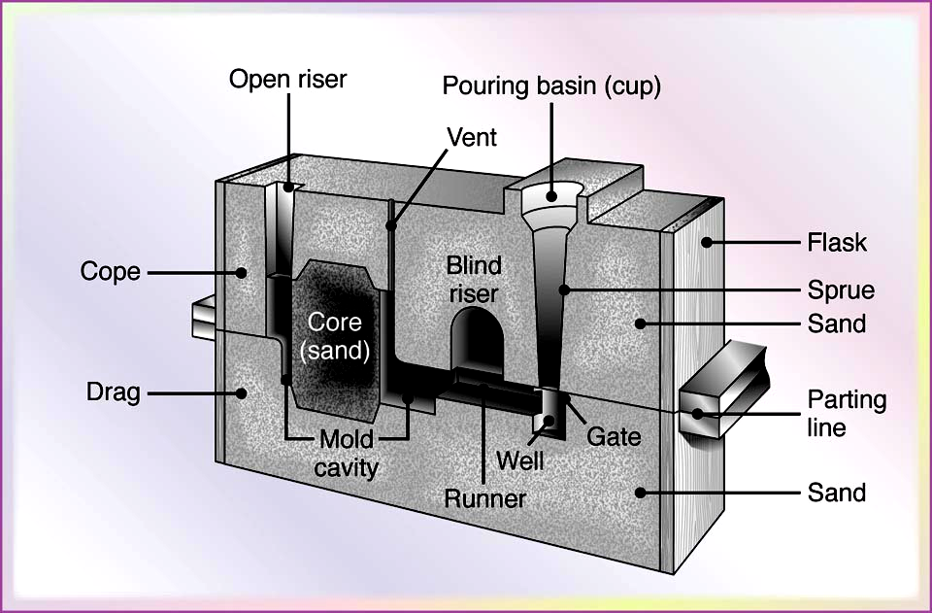
Types of Sand Molds
Sand molds (Fig. 11.3) are characterized by the types of sand that comprise them and by the methods used to produce them. There are three basic types of sand molds: green-sand, cold-box and no-bake molds. The most common mold material is green molding sand, which is a mixture of sand, clay and water.
Figure 11.3 Schematic illustration of a sand mold, showing various features.

Slide 17
The term “green” refers to the fact that the sand in the mold is moist or damp while the metal is being poured into it. Green-sand molding is the least expensive method of making molds and the sand is recycled easily for subsequent reuse. In the skin-dried method, the mold surfaces are dried, either by storing the mold in air or by drying it with torches. Because of their higher strength, these molds generally are used for large castings.

Slide 18
In the cold-box mold process, various organic and inorganic binders are blended into the sand to bond the grains chemically for greater strength. These molds are more dimensionally accurate than green-sand molds, but are more expensive.
In the no-bake mold process, a synthetic liquid resin is mixed with the sand and the mixture hardens at room temperature. Because the bonding of the mold in this and in the cold-box process takes place without heat, they are called cold-setting processes.

Slide 19
Sand molds can be oven dried (baked) prior to pouring the molten metal; then they are stronger than green-sand molds and impart better dimensional accuracy and surface finish to the casting.
However, this method has the drawbacks that (a) distortion of the mold is greater, (b) the castings are more susceptible to hot tearing because of the lower collapsibility of the mold, and (c) the production rate is lower because of the considerable drying time required.

Slide 20
Major features of molds in sand casting
The flask, which supports the mold itself. Two-piece molds consist of a cope on top and a drag on the bottom; the seam between them is the parting line. When more than two pieces are used in a sand mold, the additional parts are called cheeks.
A pouring basin or pouring cup, into which the molten metal is poured.
A sprue, through which the molten metal flows downward.
The runner system, which has channels that carry the molten metal from the sprue to the mold cavity. Gates are the inlets into the mold cavity.

Slide 21
Risers, which supply additional molten metal to the casting as it shrinks during solidification.
Cores, which are inserts made from sand. They are placed in the mold to form hollow regions or otherwise define the interior surface of the casting. Cores also are used on the outside of the casting to form features such as lettering on the surface or deep external pockets.
Vents, which are placed in molds to carry off gases produced when the molten metal comes into contact with the sand in the mold and the core. Vents also exhaust air from the mold cavity as the molten metal flows into the mold.

Slide 22
Patterns
Patterns are used to mold the sand mixture into the shape of the casting and it may be made of wood, plastic or metal. The selection of a pattern material depends on the size, shape of the casting, dimensional accuracy required, the and the molding process. Because patterns are used repeatedly to make molds, the strength and durability of the material selected for a pattern must reflect the number of castings that the mold will produce. Patterns may be made of a combination of materials to reduce wear in critical regions and they usually are coated with a parting agent to facilitate the removal of the casting from the molds.

Slide 23
Patterns can be designed with a variety of features to fit specific applications and economic requirements.
One-piece patterns also called loose or solid patterns generally are used for simpler shapes and low quantity production; they generally are made of wood and are inexpensive.
Split patterns are two-piece patterns, made such that each part forms a portion of the cavity for the casting; in this way, castings with complicated shapes can be produced.

Slide 24
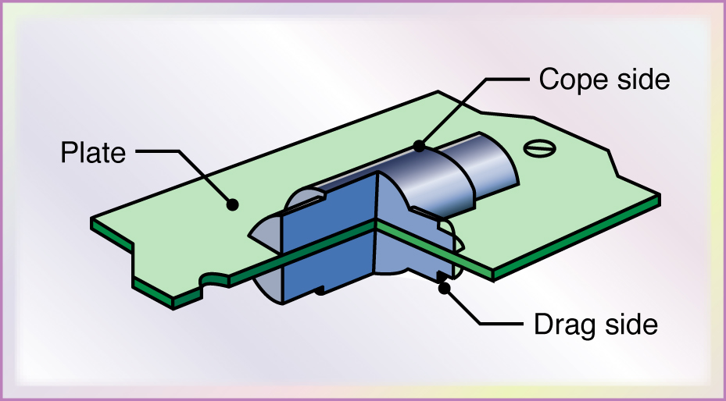
A typical metal match-plate pattern used in sand casting | Match-plate patterns are a common type of mounted pattern in which two-piece patterns are constructed by securing each half of one or more split patterns to the opposite sides of a single plate.
In such constructions, the gating system can be mounted on the
drag side of the pattern. This type of pattern is used most often
in conjunction with molding machines and large production runs
to produce smaller castings.

Slide 25
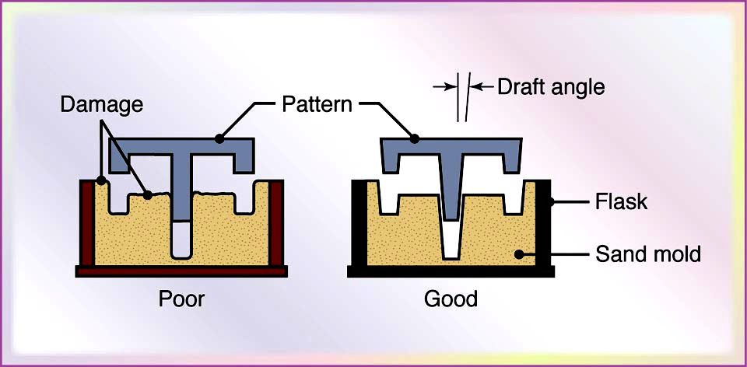
Taper on patterns for ease of removal from the sand mold | Pattern design is a critical aspect of the total casting operation. The design should provide for metal shrinkage, permit proper metal flow in the mold cavity and allow the pattern to be easily removed from the sand mold by means of a taper or draft or some other geometric feature.

Slide 26
Cores
For castings with internal cavities or passages, such as those found in an automotive engine block or a valve body, cores are utilized. Cores are placed in the mold cavity to form the interior surfaces of the casting and are removed from the finished part during shakeout and further processing. Like molds, cores must possess strength, permeability, the ability to withstand heat and collapsibility; hence, cores are made of sand aggregates. The core is anchored by core prints, which are recesses added to the pattern to locate and support the core and to provide vents for the escape of gases (Fig. 11.6a).

Slide 27
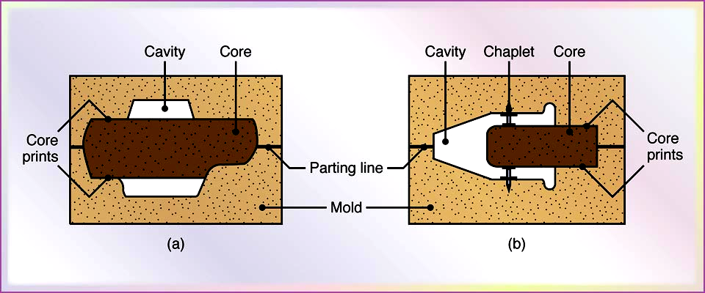
A common problem with cores is that they may lack sufficient structural support in the cavity. To keep the core from shifting, metal supports (chaplets) may be used to anchor the core in place (Fig. 11.6b). Cores generally are made in a manner similar to that used in sand mold making; the majority are made with shell, no-bake, or cold-box processes. Cores are shaped in core boxes, which are used in much the same way that patterns are used to form sand molds.
Sand cores showing core prints and chaplets to support cores

Slide 28
The Sand-casting Operation
After the mold has been shaped and the cores have been placed in position, the two halves (cope and drag) are closed, clamped and weighted down to prevent the separation of the mold sections under the pressure exerted when the molten metal is poured into the mold cavity. A complete sequence of operations in sand casting is shown in Next Slides.

Slide 29
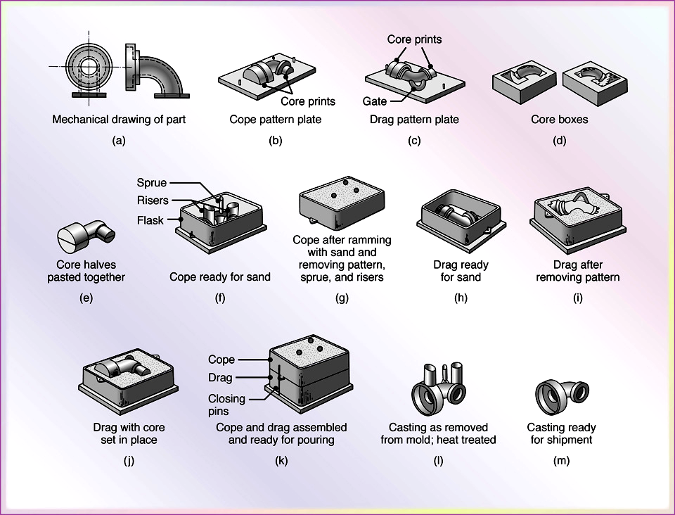
Sequence of Operations for
Sand-Casting
Figure 11.8 Schematic illustration of the sequence of operations for sand casting. (a) A mechanical drawing of the part is used to generate a design for the pattern. Considerations such as part shrinkage and draft must be built into the drawing. (b-c) Patterns have been mounted on plates equipped with pins for alignment. Note the presence of core prints designed to hold the core in place. (d-e) Core boxes produce core halves, which are pasted together. The cores will be used to produce the hollow area of the part shown in (a). (f) The cope half of the mold is assembled by securing the cope pattern plate to the flask with aligning pins and attaching inserts to form the sprue and risers. Continued on next slide.

Slide 30
Sequence of Operations for Sand-Casting, Con’t.
(g) The flask is rammed with sand and rthe plate and inserts are removed. (h) The drag half is produced in a similar manner with the pattern inserted. A bottom board is placed below the drag and aligned with pins. (i) The pattern , flask, and bottom board are inverted; and the pattern is withdrawn, leaving the appropriate imprint. (j) The core is set in place within the drag cavity. (k) The mold is closed by placing the cope on top of the drag and securing the assembly with pins. The flasks the are subjected to pressure to counteract buoyant forces in the liquid, which might lift the cope. (l) After the metal solidifies, the casting is removed from the mold. (m) The sprue and risers are cut off and recycled, and the casting is cleaned, inspected, and heat treated (when necessary).

Slide 31
Advantages of Sand Casting
Use is widespread; technology well developed.
Materials are inexpensive, capable of holding detail and resist deformation when heated.
Process is suitable for both ferrous and non-ferrous metal castings.
Handles a more diverse range of products than any other casting method.
Produces both small precision castings and large castings of up to 1 tonne.
Can achieve very close tolerances if uniform compaction is achieved.
Mould preparation time is relatively short in comparison to many other processes.
The relative simplicity of the process makes it ideally suited to mechanization.
High levels of sand reuse are achievable

Slide 32
Limitations
Typically limited to one or a small number of moulds per box
Sand : metal ratio is relatively high
High level of waste is typically generated, particularly sand, bag house dust and spent shot

Slide 33
Shell-Molding Process
Shell moulding process is well suited to rapid, automated, repetitive and high-volume production. The most common method for producing shell moulds is to use a dump box as shown in the diagram. The dump box is rotated through 360 degree so that the sand contacts the heated surface. An organic thermosetting resin such as phenol formaldehyde or furnace is typically used (2.5–4.5% of sand volume) in conjunction with a catalyst (11– 14% of resin volume). Catalysts include weak aqueous acids such as ammonium chloride or hexamine, a white powder.

Slide 34
The thickness of the shell, typically around 10 mm, is determined by the contact time between the sand and pattern. The mould is heated again to cure the sand, causing it to harden. The mould is released from the pattern using ejector pins. The entire cycle can be completed in a matter seconds, making it suitable for rapid production.
Cores are added to the mould and the two halves of the mould are glued and clamped together before the metal is poured. Moulds are relatively robust and can therefore be stored for reasonably long periods of time. Depending on the cores used, spent sand can be reclaimed successfully using thermal reclamation.

Slide 35
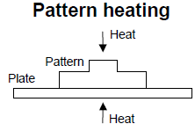
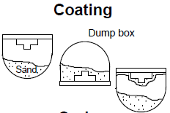
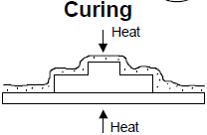
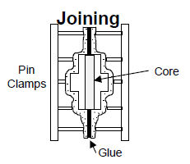
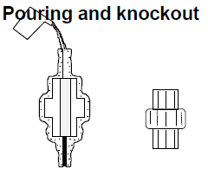
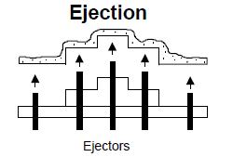

Slide 36
Advantages
Good casting detail and dimensional accuracy are possible.
Moulds are lightweight and may be stored for extended periods of time.
Gives superior surface finish and higher dimensional accuracy.
Has better flexibility in design than die-casting.
Is less expensive than investment casting.
Capital plant costs are lower than for mechanized green sand moulding.
Metal yields are relatively high.
Sand: metal ratios are relatively low.

Slide 37
Limitations
The weight of castings is limited to 100 kg.
Because the process requires heat to cure the mould, pattern costs and pattern wear can be higher than for conventional sand moulding.
Energy costs also tend to be higher.
Sand inputs need to be of higher quality than traditional sand casting.
Emissions from the process are noxious, so effective extraction systems are required.
Material costs tend to be higher than those for conventional sand moulding.

Slide 38
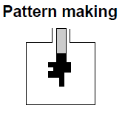
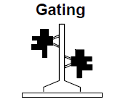
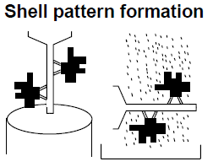
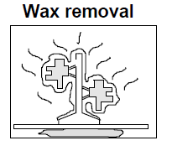
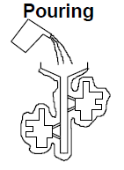
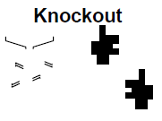
Investment Casting

Slide 39
Investment casting produces very high surface quality and dimensional accuracy. It is commonly used for precision equipment such as surgical equipment, for complex geometries and for precious metals. This process is commonly used by artisans to produce highly detailed artwork.
The first step is to produce a pattern or replica of the finished mould. Wax is most commonly used to form the pattern, although plastic is also used. Patterns are typically mass-produced by injecting liquid or semi-liquid wax into a permanent die. Prototypes, small production runs and specialty projects can also be undertaken by carving wax models. Cores are typically unnecessary but can be used for complex internal structures.

Slide 40
Rapid prototyping techniques have been developed to produce expendable patterns. Several replicas are often attached to a gating system constructed of the same material to form a tree assembly. In this way multiple castings can be produced in a single pouring.
The next stage is to create a one-piece destroyable mould around the pattern. This mould is built up around the wax pattern in stages by alternately coating the assembly with a specially formulated heat-resistant refractory slurry mixture and then applying a granulated refractory ‘stucco’ shell.

Slide 41
The initial coats use a fine powder, which creates a very smooth and dimensionally accurate negative of the pattern. Subsequent coats use a coarser refractory material to build up sufficient thickness.
This material hardens around the assembly at room temperature. This investment shell casting method is the more common process. An alternative process is to use an investment flask, where sand is packed around the mould. This can be desirable where additional mould strength is required and also allows the casting size to be increased. In both shell and flask casting, the pattern is removed from the mould prior to the pouring stage. The mould is inverted and heated to melt and remove the wax. In some operations the melted wax is recovered and reused to make new patterns.

Slide 42
After multiple reuses the material needs to be reconditioned to maintain its purity, or disposed of. The mould is then heated in an oven to remove any residual wax and to further cure and harden the mould. The temperature is raised to 980 °C prior to pouring. This is a time- and energy-consuming process: total heating time, from wax removal to pouring, can take up to 15 hours.
Molten metal is then poured into the central cavity and flows into the individual moulds. After the metal has cooled, the mould material is removed.
Because of its very high dimensional accuracy the process can achieve a net shape cast requiring little or no machining. Great care is taken in the patternmaking stage to remove any mould lines because it is more cost effective to remove unwanted material from the wax model than from the final cast.

Slide 43
Advantages
There is very high dimensional accuracy and surface finish.
Process is suitable for both ferrous and non-ferrous precision pieces.
Allows design flexibility.
The process can be adapted for mass production.
Cores are typically eliminated.
Eliminate the need of machining.
Very high metal yields.
It can produce a casting which is difficult to produce with other casting methods and machining processes.
Cost effective for repetitive casting.

Slide 44
Limitations
The size of castings is limited (up to around 5 kg).
Capital and operating costs are high in comparison with other casting methods.
Costs of pattern die-making are high, requiring special tooling and equipment.
There are numerous steps in the process, making automation somewhat more difficult and more expensive than for other casting methods.
Casting costs make it important to take full advantage of the process to eliminate all machining operations.

Slide 45
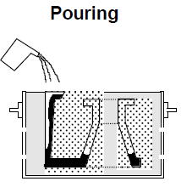
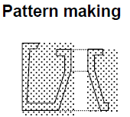
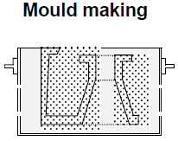

Lost Foam Casting

Slide 46
The lost foam casting process is a relatively new process, but it is gaining increased attention due to the environmental and technical benefits. In this process, an expendable pattern is formed with polystyrene foam. Patterns can be made manually or with automated systems. Manual pattern making typically involves carving blocks and gluing sections together to build up the desired shape. The finished pattern is a single piece incorporating all necessary gating systems. This carving process can be automated using computer-aided manufacturing (CAM) system. For repetitive castings, patterns can be moulded using a permanent aluminium die. Polystyrene beads are pre-expanded using a vacuum, steam or hot air processes. This helps to minimised the density of the foam as much as possible and also minimise the amount of vapour produced during the pouring process.

Slide 47
The expanded material is then blown into the aluminium mould. Steam is used to cause the material to expand further, bond together and fill the mould cavity. The mould and pattern are allowed to cool and followed by pattern ejected. As in investment casting, when the casting is small, multiple castings can be joined, often to a central tree, to increase pouring efficiency. The pattern is coated with specially formulated gas permeable refractory slurry. When the refractory slurry has hardened, the assembly is positioned in a flask and unbonded sand is poured around the mould and compacted into any internal cavities. The refractory coating must be sufficiently strong to prevent the loose sand from collapsing into the cavity as the pattern vaporises, but also permeable to allow styrene vapour to escape from the mould cavity. A vacuum system can also be used to increase sand compaction.

Slide 48
Molten metal is then poured into the polystyrene pattern, which vaporises and is replaced by the metal. This is different from the lost wax process in which the wax is removed before the pouring stage. Vents in the side of the flask allow vapour to escape. If vapour is produced more rapidly than it can be vented, the casting may become deformed. When the metal has solidified, the flask is emptied onto a steel grate for shakeout. The loose sand falls through the grate and can be reused without treatment. The refractory material is broken away from the casting in the usual manner.

Slide 49
Advantages
Used for precision castings of ferrous and non-ferrous metals of any size.
Fewer steps are involved in lost foam casting compared to sand casting.
Core making is eliminated.
Binders or other additives and related mixing processes are eliminated.
High dimensional accuracy can be achieved and thin sections can be cast (i.e. 3 mm).
Lower capital investment and labor skill required.
The flasks used are less expensive and easier to use because they are in one piece.
Multiple castings can be combined in one mould to increase pouring efficiency.

Slide 50
Lower operating costs can be achieved for appropriate castings. Complex castings, particularly internal sections, which require high dimensional accuracy and have thin sections, can be produced very cost effectively in comparison with to conventional sand moulding processes.
Fettling (the removal of feeders and excess material from a casting) and machining is minimised due to high dimensional accuracy and the absence of parting lines or core fins.
The shakeout process is simplified and does not require the heavy machinery required for bonded sand systems.
High levels of sand reuse are possible.

Slide 51
Limitations
The pattern coating process is time-consuming and pattern handling requires great care.
Very thin sections can be flimsy, making dimensional accuracy difficult to maintain during sand compaction.
Good process control is required as a scrapped casting means replacement not only of the mould but of the pattern as well.
For simple casings and for jobbing processes, the process is typically not competitive against conventional sand moulding.
With the exception of aluminium and grey and ductile iron, experience with other metals is limited.
There are some limitations in using the technique to cast low-carbon alloys.
Jobbing processing, is one in which resources are allocated to multiple projects at the same time. Jobbing processes differ from project processes, where the various resources are typically directed towards the completion of one project. In the jobbing process, a high variety of products are generally produced, but at a lower volume.

Slide 52
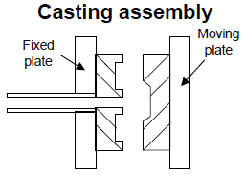
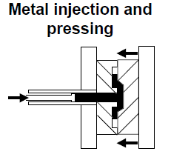
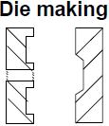
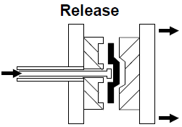
Die Casting Process

Slide 53
Die casting is a precision casting technique which uses a permanent metal mould or die. Metal is typically forced into the mould under pressure but gravity-feed systems are also used. Tooling costs and other capital costs are high due to the cost of designing dies. Operational costs, however, are relatively low, due to the high level of automation and the small number of production steps. The process, therefore, is best suited to mass production. Die casting is most suitable for non-ferrous metals with relatively low melting points such as lead, zinc, aluminium, magnesium and some copper alloys.

Slide 54
Dies are usually made from two blocks of steel, each containing part of the cavity, which are locked together while the casting is being made. Retractable and removable cores are used to form internal surfaces. Molten metal is injected into the die and held under pressure until it cools and solidifies. The die halves are then opened and the casting is removed, usually by means of an automatic ejection system. The die is cleaned between each casting cycle, preheated and lubricated to reduce wear on the die, to improve surface quality and to aid ejection. Mould coating material can also be used to protect the molten metal from the relatively cool and conductive surface of the mould.

Slide 55
Advantages
Once capital is in place, operating costs are low relative to most other casting processes.
Dies can sustain very high production rates (i.e. over 400 shots per hour). Total cost of castings can be relatively low at high levels of production.
High design flexibility and complexity allows products to be manufactured from a single casting instead of from an assembly of cast components.
Good accuracy, consistency and surface finish are possible, with high metal yields.
Cleaning, machining, finishing and fabrication costs are low.
There are low levels of waste due to elimination of refractory material, leading to a cleaner work environment.

Slide 56
Limitations
Capital costs for equipment and dies are high.
Pressure dies are very expensive to design and produce.
Die casting is not applicable to steel and high-melting-point alloys.
Casting size is limited to a maximum of about 35 kg.

Slide 57
Centrifugal Casting
For centrifugal casting, molten metal is introduced into a mould that is rotated during solidification. The centrifugal force improves the feed and filling consistency achieving surface detail. This method has been specifically adapted to the production of cylindrical parts and eliminates the need for gates, risers and cores. The process is typically unsuitable for geometries that do not allow a linear flow-through of metal

Slide 58
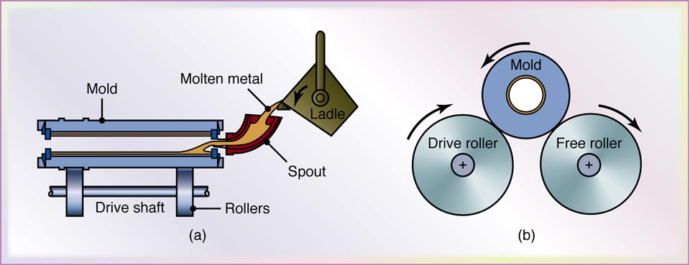
Centrifugal-Casting Process
(a) Schematic illustration of the centrifugal-casting process. Pipes, cylinder liners, and similarly shaped parts can be cast with this process. (b) Side view of the machine.

Slide 59
Advantages
Centrifugal casting improves homogeneity and accuracy in special circumstances.
Eliminates the need for gating systems.
Limitations
The process imposes limitations on the shape of castings, and is normally restricted to the production of cylindrical geometric shapes.

Slide 60
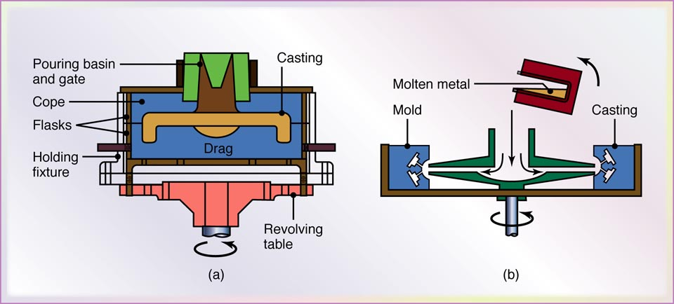
Semicentrifugal Casting and Casting by Centrifuging
(a) Schematic illustration of the semicentrifugal casting process. Wheels with spokes can be cast by this process. (b) Schematic illustration of casting by centrifuging. The molds are placed at the periphery of the machine, and the molten metal is forced into the molds by centrifugal force.

Slide 61
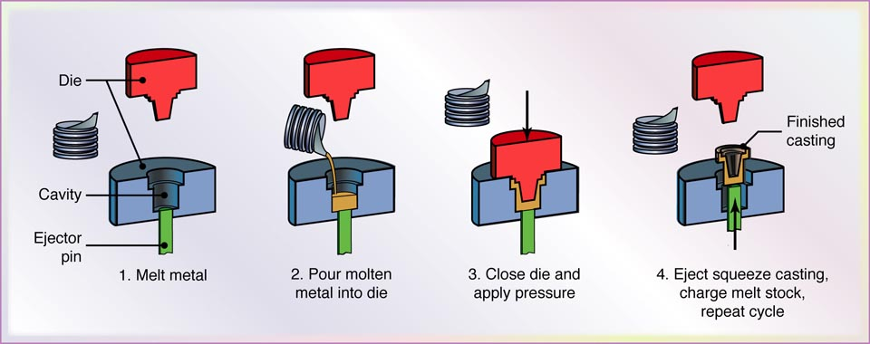
Squeeze-Casting
Sequence of operations in the squeeze-casting process. This process combines the advantages of casting and forging.

Slide 62
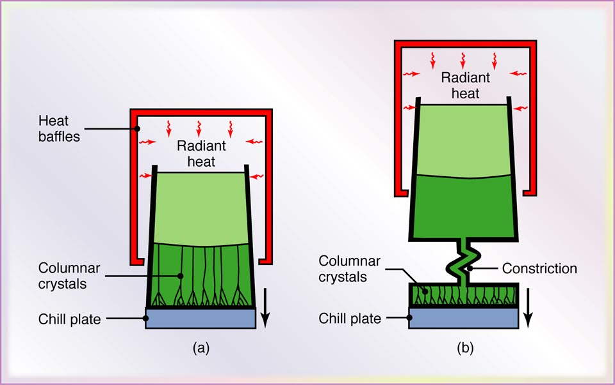
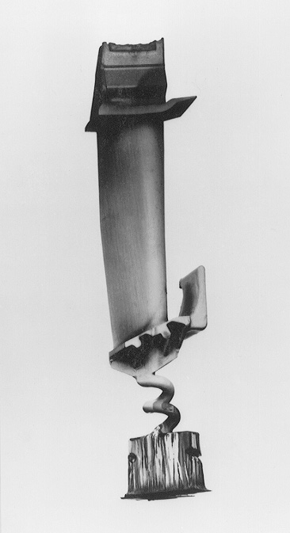
Methods of Casting Turbine Blades
(c)
Methods of casting turbine blades: (a) directional solidification; (b) method to produce a single-crystal blade; and (c) a single-crystal blade with the constriction portion still attached.

Slide 63
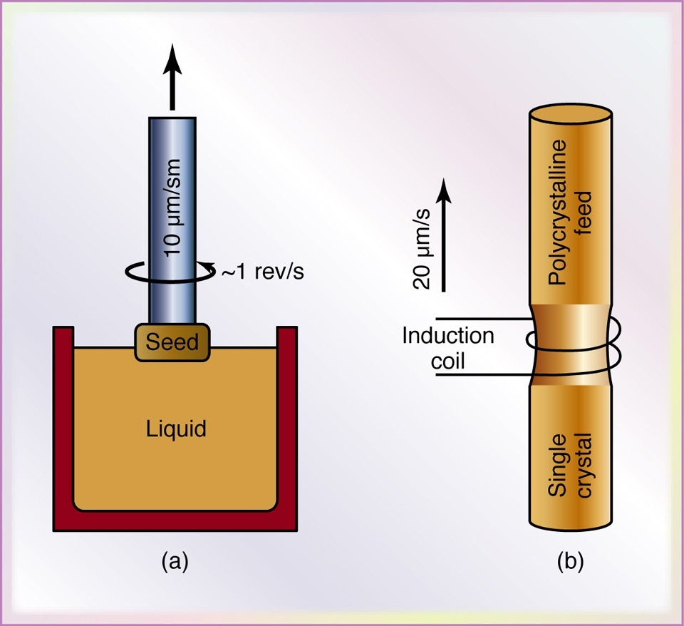
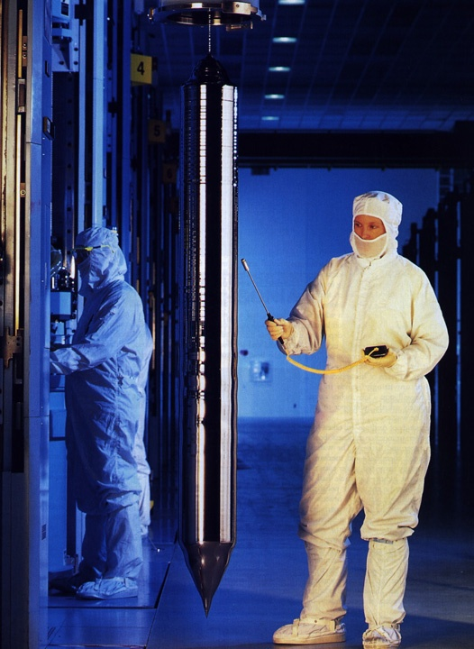
Crystal Growing
Two methods of crystal growing: (a) crystal pulling (Czochralski process) and (b) the floating-zone method. Crystal growing is important especially in the semiconductor industry. (c) A single-crystal ingot produced by the Czochralski process
(c)

Slide 64
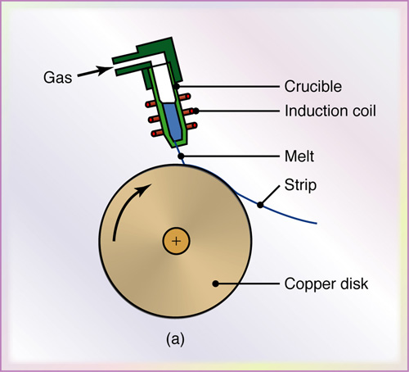
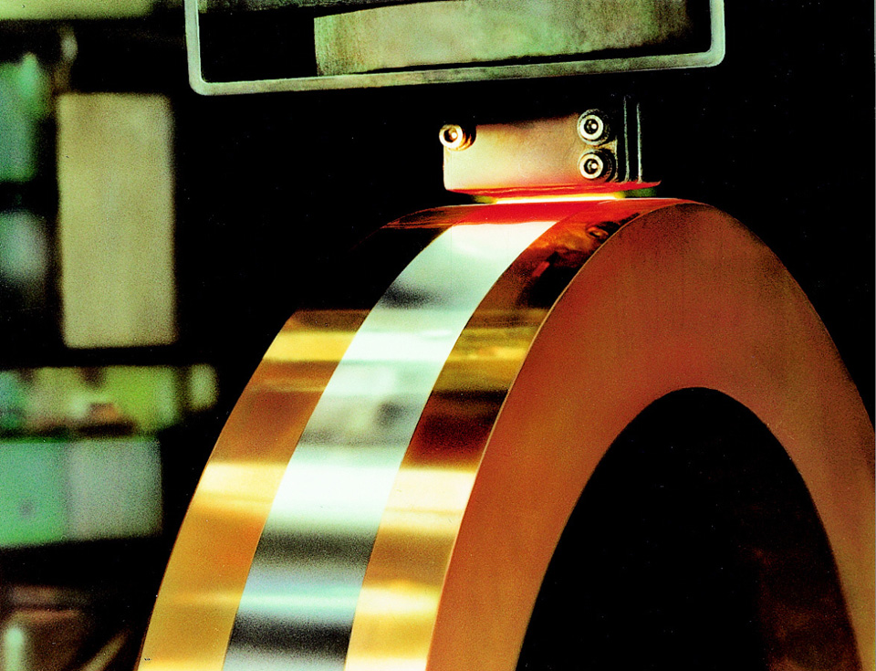
Melt-Spinning
(b)
Schematic illustration of melt-spinning to produce thin strips of amorphous metal. (b) Photograph of nickel-alloy production through melt-spinning

Slide 65
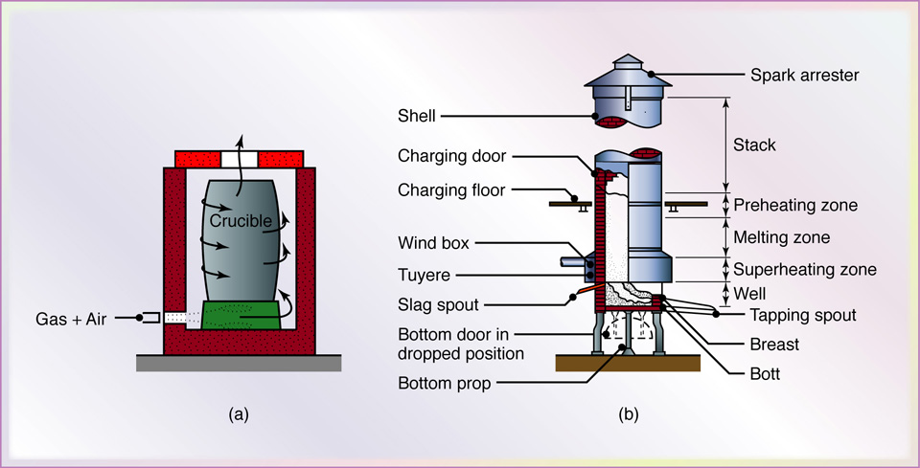
Types of Melting Furnaces
Two types of melting furnaces used in foundries: (a) crucible, and (b) cupola.

